Slide 1
18CSC304J COMPILER DESIGN
UNIT 5
SESSIONS 11 & 12

Slide 2
Topics that will be covered
Parameter Passing
Runtime Environments
Source Language Issues
Storage Organization

Slide 3
PARAMETER PASSING

Slide 4
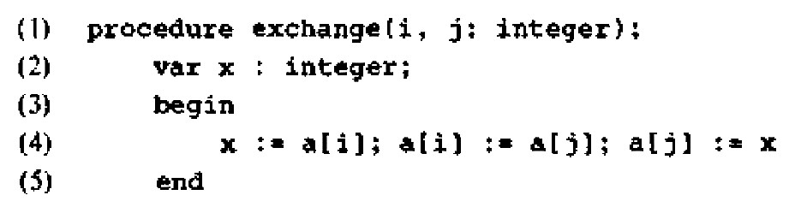
Parameter Passing
When one procedure calls another, the usual method of communication between them is through nonlocal names and through parameters of the called procedure
Example for a procedure
Both nonlocals and parameters are used by the procedure to exchange the values of a[i] and a[j]
Here, the array a is nonlocal to the procedure exchange, and i and j are parameters

Slide 5
Parameter Passing – cont..
Some of the common methods for associating actual and formal parameters are
Call-by-value
Call-by-reference
Copy-restore
Call-by-name
In an assignment like
a[i] := a[j]
a[j] represents a value
a[i] represents a storage location into which the value of a[j] is placed
The term l-value refers to the storage represented by an expression
The term r-value refers to the value contained in the storage
Differences between parameter-passing methods are based primarily on whether an actual parameter represents an r-value, an l-value, or the text of the actual parameter itself

Slide 6
Call-by-value
This is the simplest possible method of passing parameters
The actual parameters are evaluated and their r-values are passed to the called procedure
Call-by-value can be implemented as follows:
A formal parameter is treated just like a local name. So the storage for the formals is in the activation record of the called procedure
The caller evaluates the actual parameters and places their r-values in the storage for the formals
The operations on the formal parameters do not affect values in the activation record of the caller

Slide 7
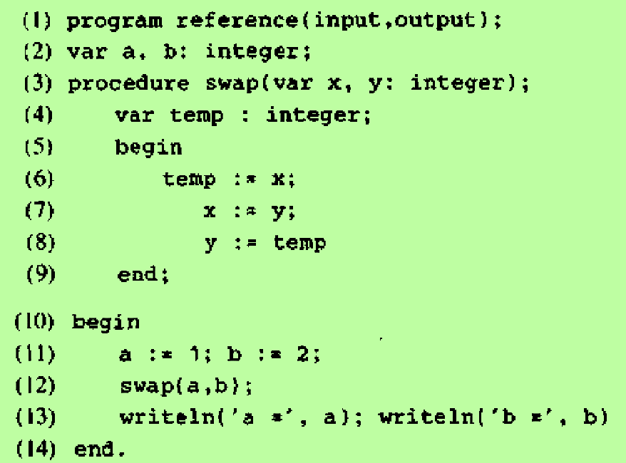
Call-by-value – cont..
In this program, the call swap(a,b) leaves the values of a and b undisturbed
Its effect is equivalent to the sequence of steps
x := a
y := b
temp := x
x := y
y := temp
The values of locals, x, y and temp are changed
This has no effect on the activation record of the caller

Slide 8
Call-by-Reference
This method is also known as “call-by-address” or “call-by-location”
When parameters are passed by reference, a pointer to the storage address of each actual parameter is passed
If the actual parameter is a name or an expression having an l-value, then that l-value itself is passed
If the actual parameter is an expression like a+b or 2 that has no l-value, then the expression is evaluated in a new location and the address of that location is passed
Thus the changes that are made in the called procedure will affect the actual parameters
Example: Consider a call to swap – swap( i , a [ i ] )
Copy the l-values of i and a[i] into the activation record of the called procedure
Set temp to the contents of the location pointed to by arg1
Set the contents of location pointed to by arg1 to the value of the location pointed to by arg2
Set the contents of location pointed to by arg2 equal to the value of temp

Slide 9
Copy-Restore
It is a hybrid between call-by-value and call-by-reference
It is also known as “copy-in-copy-out” or “value-result”
Steps:
Before control flows to the called procedure, the actual parameters are evaluated. The r-values of actuals are passed to the called procedure. The l-values of the actual parameters are determined before call
When control returns, the current r-values of the formal parameters are copied back into the l-values of the actuals. Only actuals having l-values are copied
The first step copies-in the values of actuals into the activation record of the called procedure
The second step “copies-out” the final values of the formals into the activation record of the calls

Slide 10
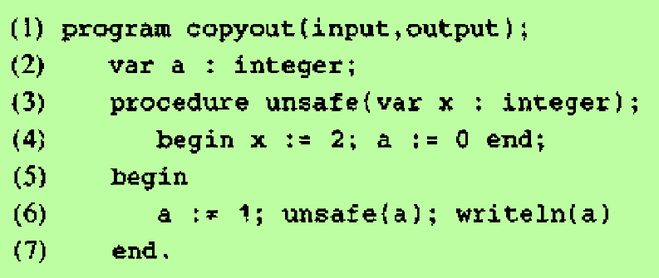
Copy-Restore – cont..
The value 1 of actual a is copied into formal x
The final value 2 of x is copied out into the l-value of a
So the final value of a is 2

Slide 11
Call-by-Name
Call-by-name is traditionally defined by the copy-rule of Algol, which is
The procedure is treated as if it were a macro; that is, its body is substituted for the call in the caller, with the actual parameters literally substituted for the formals. Such a literal substitution is called macro-expansion or in-line expansion
The local names of the called procedure are kept distinct from the names of the calling procedure. We can think of each local of the called procedure being systematically renamed into a distinct new name before the macro-expansion is done
The actual parameters are surrounded by parenthesis if necessary to preserve their integrity
Example:
The call swap ( i , a[i] ) would be implemented as though it were
temp := i
i := a[i]
a[i] := temp
Although call-by name is of theoretical interest, a related technique, in-line expansion has been suggested for reducing the running time of a program

Slide 12
RUNTIME ENVIRONMENTS

Slide 13
Run-Time Environments
This topic relates the static source text of a program to the actions that must occur at run time to implement the program
As execution proceeds, the same name in the source text can denote different data objects in the target machine
The relationship between names and data objects are examined in this section
The allocation and deallocation of data objects is managed by the run-time support package, consisting of routines loaded with the generated target code
The design of the run-time support package is influenced by the semantics of procedures
Each execution of a procedure is referred to as an activation of the procedure
If the procedure is recursive, several of its actions may be alive at the same time
The representation of a data object at run time is determined by its type
Elementary data types, such as characters, integers, and reals, can be represented by equivalent data objects in the target machine
However, aggregates, such as arrays, strings, and structures, are usually represented by collection of primitive objects

Slide 14
SOURCE LANGUAGE ISSUES

Slide 15
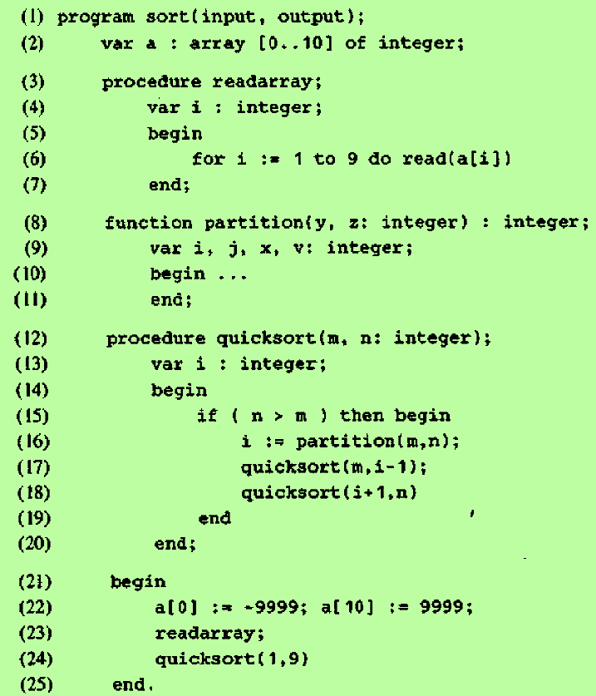
Procedures
Suppose that a program is made up of procedures
A procedure definition is a declaration that associates an identifier with a statement
This identifier is the procedure name and the statement is the procedure body
For example, the Pascal code shown in the figure contains the definition of the procedure named readarray on lines 3-7. The body of the procedure is on lines 5-7
Procedures that return values are called functions in many languages
A complete program will also be treated as a procedure

Slide 16
Procedures – cont..
When a procedure name appears within an executable statement, we say that the procedure is called at that point
The basic idea is that a procedure call executes the procedure body
The main program in lines 21-25 calls the procedure readarray at line 23 and then calls quicksort at line 24
The procedure calls can also occur within expressions, as on line 16
Some of the identifiers appearing in a procedure definition are special, and are called formal parameters (or just formals) of the procedure
The identifiers m and n on line 12 are formals
Arguments, known as actual parameters (or actuals) may be passed to a called procedure; they are substituted for the formals in the body

Slide 17
Activation Trees
We make the following assumptions about the flow of control among procedures during the execution of a program:
Control flows sequentially; that is, the execution of a program consists of a sequence of steps, with control being at some specific point in the program at each step
Each execution of a procedure starts at the beginning of the procedure body and returns control to the point immediately following the place where the procedure was called
Each execution of a procedure body is referred to as an activation of the procedure
The lifetime of an activation of a procedure p is the sequence of steps between the first and last steps in the execution of the procedure body, including the time spent executing procedures called by p, the procedures called by them and so on
If a and b are procedure activations, then their lifetimes are either non-overlapping or nested; that is, if b is entered before a is left, then control must leave b before it leaves a
A procedure is recursive if a new activation can begin before an earlier activation of the same procedure has ended
A recursive procedure p need not call itself directly; p may call a procedure q, which may then call p

Slide 18
Activation Trees – cont..
An activation tree is used to depict the flow of control between procedures, that is, the way control enters and leaves activations
In an activation tree,
Each node represents an activation of a procedure
The root represents the activation of the main program
The node for a is the parent of the node for b if and only if control flows from activation a to b
The node for a is to the left of the node for b if and only if the lifetime of a occurs before the lifetime

Slide 19
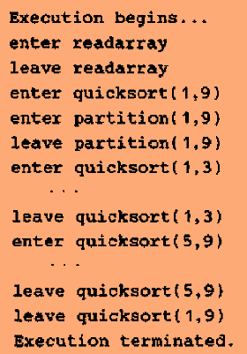
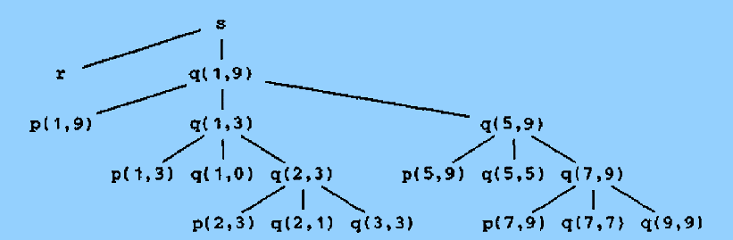
Activation Trees – Example

Slide 20
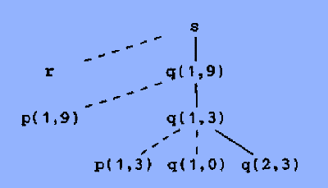
Control Stacks
The flow of control in a program corresponds to a depth-first traversal of the activation tree that starts at the root, visits a node before its children, and recursively visits children at each node in a left-to-right order
A stack called “control stack” can be used to keep track of live procedure activations
When an activation begins, the node for the activation is pushed onto the control stack
When an activation ends, the node is popped
When a node n is at the top of the control stack, the stack contains the nodes along the path from n to the root
Example:
Assume that control enters the activation represented by q(2,3)
Activations with labels r, p(1,9), p(1,3) and q(1,0) have executed to completion
So the fig. contains dashed lines
Contents of control stack
q(2,3)
q(1,3)
q(1,9)
s

Slide 21
The Scope of a Declaration
Declaration:
A declaration in a language is a syntactic construct that associates information with a name
Explicit Declaration:
Var i : integer (Pascal)
Implicit Declaration:
Any variable name starting with I is assumed to denote an integer in Fortran
Scope:
The portion of the program to which a declaration applies is called the scope of that declaration
Local:
An occurrence of a name in a procedure is said to be local to the procedure if it is in the scope of a declaration within the procedure
Non-local:
An occurrence of a name in a procedure is said to be non-local to the procedure if it is not in the scope of a declaration within the procedure
Symbol Table:
The symbol table can be used to find which declaration applies to an occurrence of a name

Slide 22
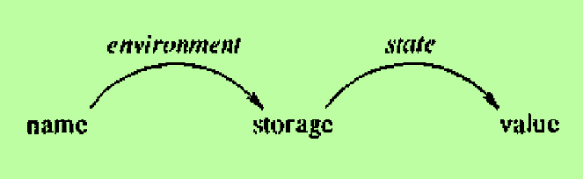
Bindings of Names
Data Objects:
Even if each name is declared once in a program, the same name may denote different data objects at run time.
The informal term “data object” corresponds to a storage location that can hold values
Environment:
In programming language semantics, the term environment refers to a function that maps a name to a storage location
An environment maps a name to an l-value
State:
The term state refers to a function that maps a storage location to the value held there
A state maps the l-value to an r-value

Slide 23
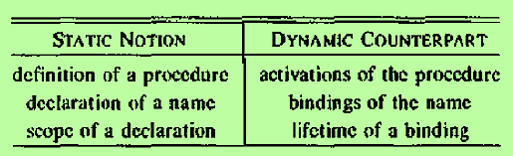
Bindings of Names – cont..
Difference between environments & states
An assignment changes the state, but not the environment
Suppose the address 100 is associated with pi and the value it holds is 0
After the assignment pi := 3.14, the same address is associated with pi, but the value held there is 3.14
Binding:
When an environment associates storage location s with a name x, we say that x is bound to s
The association itself is referred to as a binding of x
A binding is the dynamic counterpart of a declaration
More than one activation of a recursive procedure can be alive at the same time; a local variable name is bound to a different storage location in each activation of a procedure

Slide 24
STORAGE ORGANIZATION - The organization of run-time storage

Slide 25
Subdivision of Run-Time Memory
Suppose that the compiler obtains a block of storage from the operating system for the compiled program to run in
This run-time storage might be subdivided to hold
The generated target code
Data objects
A counterpart of the control stack to keep track of procedure activations
The size of the generated target code is fixed at compile time, so the compiler can place it in a statically determined area
The size of some of the data objects may also be known at compile time, and these too can be placed in a statically determined area
One reason for statically allocating as many data objects as possible is that the addresses of these objects can be compiled into the target code
All data objects in Fortran can be allocated statically

Slide 26
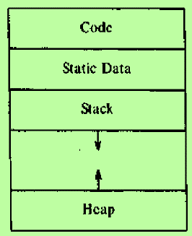
Subdivision of Run-Time Memory – cont..
Implementations of languages like Pascal and C use extensions of control stack to manage activations of procedures
When a call occurs, the execution of an activation is interrupted and information about the status of the machine, such as the value of the program counter and machine registers is saved on the stack
When control returns from the call, this activation can be restarted after restoring the values of relevant registers and program counter
Data objects whose lifetimes are contained in that of an activation can also be allocated on the stack
A separate area of run-time memory called a heap, holds all other information
The sizes of the stack and the heap can change as the program executes
They can grow toward each other as needed

Slide 27
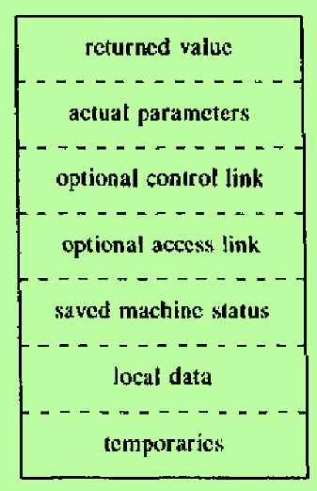
Activation Records
Information needed by a single execution of a procedure is managed using a contiguous block of storage called an activation record or frame, consisting of the collection of fields as shown in the figure
The sizes of each of these fields can be determined at the time a procedure is called
In fact, the sizes of almost all fields can be determined at compile time, except if a procedure has a local array whose size is determined by the value of an actual parameter, available only when the procedure is called at run time
When a procedure is called, its activation record is pushed onto the run-time stack and when control returns to the caller, the activation record is popped off the stack

Slide 28
Purpose of the fields in an Activation Record
Temporaries : Stores the temporary values arising in the evaluation of expressions
Local Data : Holds data that is local to an execution of a procedure
Saved Machine Status : Holds information about the state of the machine just before the procedure is called
Optional Access Link : Refers to non-local data held in other activation records
Optional Control Link : Points to the activation record of the caller
Actual Parameter : Used by the calling procedure to supply parameters to the called procedure
Returned Value : It is used by the called procedure to return a value to the calling procedure

Slide 29
Compile-Time Layout of Local Data
Suppose run-time storage comes in blocks of contiguous bytes, where a byte is the smallest unit of addressable memory. A byte is eight bits and some number of bytes form a machine word. Multibyte objects are stored in consecutive bytes and given the address of the first byte
The amount of space needed for a name is determined from its type
An elementary data type, such as a character, integer, or real, can usually be stored in an integral number of bytes
Storage for an aggregate, such as an array or record, must be large enough to hold all its components. For easy access to the components, storage for aggregates is typically allocated in one contiguous block of bytes
The field for local data is laid out as declarations in a procedure are examined at compile time
Variable-length data is kept outside this field
We keep a count of the memory locations that have been allocated for previous declarations
From the count we determine a relative address of the storage for a local with respect to some position such as the beginning of the activation record
The relative address, or offset, is the difference between the addresses of the position and the data object

Slide 30
Compile-Time Layout of Local Data – cont..
The storage layout for data objects is strongly influenced by the addressing constraints of the target machine
For example, instructions to add integers may expect integers to be aligned, that is, placed at certain positions in memory such as an address divisible by 4
Although an array of ten characters needs only enough bytes to hold ten characters, a compiler may therefore allocate 12 bytes, leaving 2 bytes unused.
Space left unused due to alignment considerations is referred to as padding
When space is at a premium, a compiler may pack data so that no padding is left
Additional instructions may then need to be executed at run time to position packed data so that it can be operated on as if it were properly aligned

Slide 31
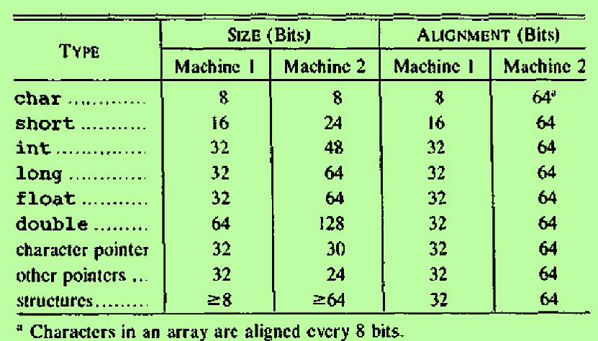
Compile-Time Layout of Local Data – Example
The figure shows a simplification of the data layout used by C compilers for two machines Machine1 & Machine 2
C provides for three sizes of integers, declared using the keywords short, int and long
The instruction sets of the two machines are such that the compiler for Machine 1 allocates 16, 32 and 32 bits for the three sizes of integers, while the compiler for Machine 2 allocates 24, 48 and 64 bits respectively
For comparison between machines, sizes are measured in bits, even though neither machine allows bits to be addressed directly

Slide 32
Compile-Time Layout of Local Data – Example
The memory of Machine 1 is organized into bytes consisting of 8 bits each
Even though every byte has an address, the instruction set favors short integers being positioned at bytes whose addresses are even and integers being positioned at addresses that are divisible by 4
The compiler places short integers at even addresses, even if it has to skip a byte as padding in the process
In Machine 2, each word consists of 64 bits.
The strong word orientation of the instruction set of Machine 2 has led the compiler to allocate a complete word at a time, even when fewer bits would suffice to represent values of that type

